Slide 1
Predicting Gender Based Violence in Mexico: A Machine Learning Approach
Ana Sofia Munoz
Gabriela Palacios
Antonia Sanhueza
Hugo Salas

Slide 2
Policy issue: Gender Based Violence
The WHO estimated that 736 million women (about 30%) have been subjected to intimate partner violence, non-partner sexual violence, or both at least once in their life
GBV is less likely to be reported compared to other forms of violence and, therefore, prevalence rates are difficult to estimate with administrative data.
UNDP reports state that one of the main problems in addressing GBV in Latin America is that specialized surveys in GBV are not sufficiently used in the region. Furthermore, because of the cost of the survey, it can't be replicated by agencies or other countries to obtain data with higher frequency.
Objective: Make a cost-effective tool that identifies victims of GBV

Slide 3

Data Source
National Survey about the Dynamic of Relations in the Household (ENDIREH) 2016
142,363 households
72, 855 women
Sociodemographic characteristics, perception of gender roles, economic independence, and support system.
National Institute of Statistics and Geography - INEGI
Mexico

Slide 4
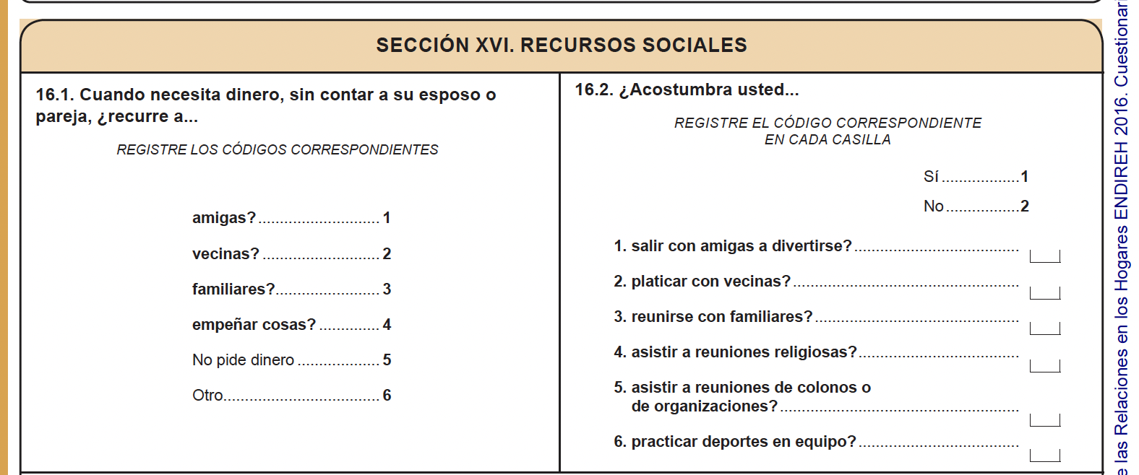
Survey structure
General
A. Married or united women
B. Separated or divorced women
C. Single women
Aggregated household information
3 sections
Individual woman information.
19 sections
Sociodemographic
Violence
Trust

Slide 5
Descriptive Statistics

Slide 6
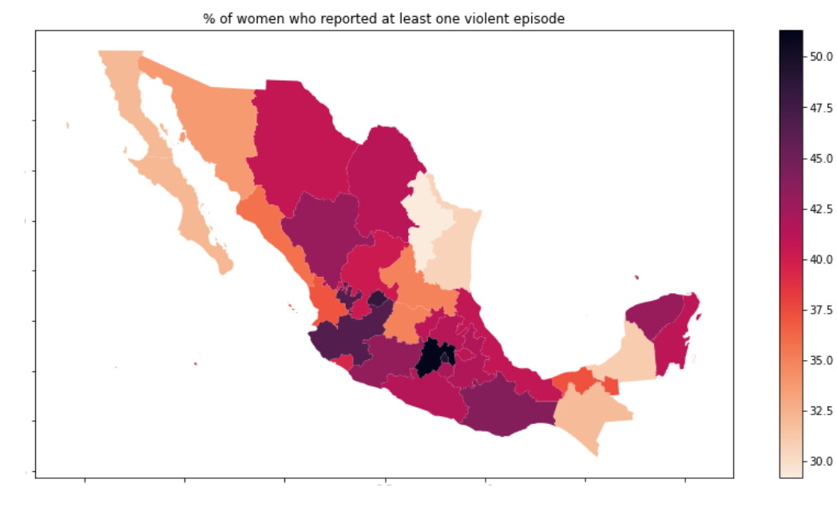
Descriptive statistics:
Geographic prevalence of GBV in Mexico

Slide 7
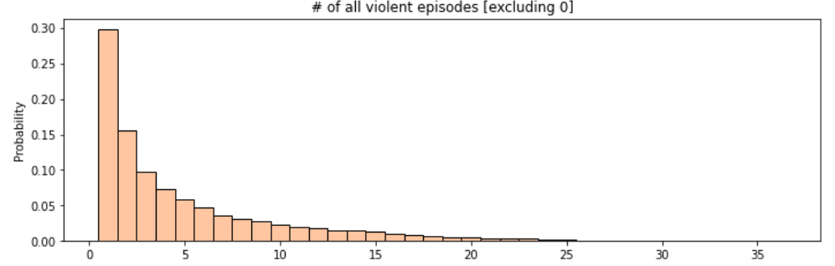
Descriptive statistics:
Distribution of the number of violent episodes

Slide 8
Machine Learning: Pre-processing
Missing value imputation:
Numeric variables: median
Categorical variables: mode
Expansion of categorical variables
Correlation and polynomials
Removing highly correlated and constant variables

Slide 9
Machine Learning: Models
Logistic regression - Elastic Net
Tree
Random Forest
PCA and Clustering
10 fold cross-validation

Slide 10
Machine Learning:
Scoring Metrics
Model | Recall | Precision | Accuracy
Logistic | 0.45 | 0.52 | 0.62
Tree | 0.60 | 0.46 | 0.57
Random Forest | 0.56 | 0.50 | 0.61
Notes:
Precision: share of women classified as victims who are actually victims. Recall: share of all victims that were correctly classified as victims

Slide 11
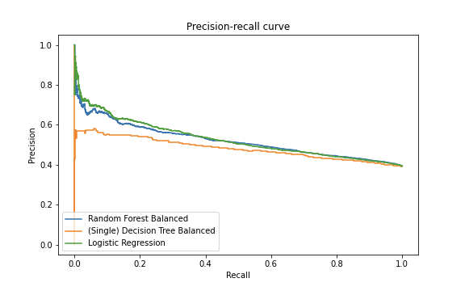
Machine Learning:
Precision - Recall Curve
Notes:
Ojo con los ejes!

Slide 12
Machine Learning:
Precision - Recall Curve
Notes:
Ojo con los ejes!

Slide 13
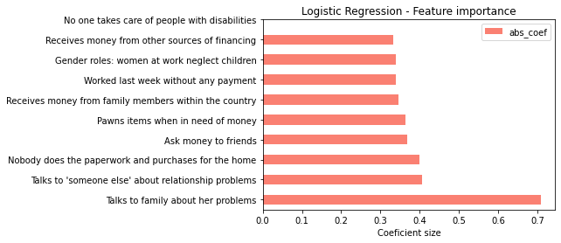
Machine Learning:
Feature Importance
Notes:
Ojo con los ejes!

Slide 14
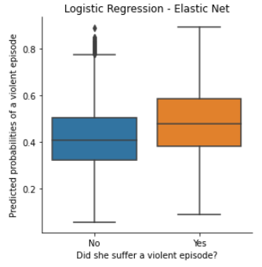
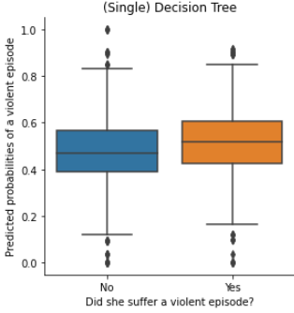
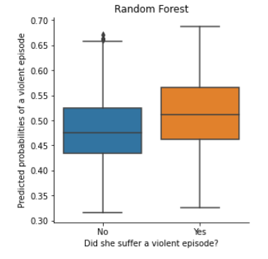
Machine Learning:
Prevalence
Notes:
Ojo con los ejes!

Slide 15
Policy implications
This paper represents an initial step towards using machine-learning methodology to predict gender-based violence in Mexico.
Even though the metric scores of all of our models are not as high, we do get similar features when obtaining the feature importance of each of the models.
Notes:
Ojo con los ejes!

Slide 16
Caveats, Limitations, and Ethics
Possible statistical bias: lack of reporting
Absence of causal inference
Caution in the implementation of the tool
Human subjects need informed consent
We must also protect the privacy of the information they provide, and of the possible treatment they might receive due to this
Notes:
Ojo con los ejes!

Slide 17
Predicting Gender Based Violence in Mexico: A Machine Learning Approach
Ana Sofia Munoz
Gabriela Palacios
Antonia Sanhueza
Hugo Salas

